Slide 1

Object Design – Specifying Interfaces
Dan CHIOREAN
mainly based on chapter 9 of Bruegge’s book

Slide 2

An Overview of Interface Specification
At this point, we have made many decisions about the system and produced a wealth of models:
The analysis object model describes the entity, boundary, and control objects that are visible to the user. AOM includes attributes and operations for each object.
Subsystem decomposition describes how these objects are partitioned into cohesive pieces realized by different teams of developers. Each subsystem includes high-level service descriptions that indicate which functionality it provides to the others.
Hardware/software mapping identifies the components that make up the virtual machine on which we build solution objects. This may include classes and APIs defined by existing components.

Slide 3
An Overview of Interface Specification_2
At this point, we have made many decisions about the system and produced a wealth of models:
Boundary use cases describe, from the user’s point of view, administrative and exceptional cases that the system handles.
Design patterns selected during object design reuse describe partial object design models addressing specific design issues.

Slide 4
An Overview of Interface Specification_3
All these models, however, reflect only a partial view of the system. Many puzzle pieces are still missing, and many others are yet to be refined. The goal of object design is to produce an object design model that integrates all of the above information into a coherent and precise whole. Interface specification includes the following activities:
Identify missing attributes and operations. During this activity, we examine each subsystem service and each analysis object. We identify missing operations and attributes that are needed to realize the subsystem service. We refine the current object design model and augment it with these operations.

Slide 5
An Overview of Interface Specification_4
Specify visibility and signatures. During this activity, we decide which operations are available to other objects and subsystems, and which are used only within a subsystem. We also specify the return type of each operation as well as the number and type of its parameters. The goal of this activity is to reduce coupling among subsystems and provide a small and simple interface that can be understood easily by a single developer.
Specify contracts. During this activity, we describe in terms of constraints the behavior of the operations provided by each object. For each operation, we describe the conditions that must be met before the operation is invoked and a specification of the result after the operation returns.

Slide 6
An Overview of Interface Specification_5
The large number of objects and developers, the high rate of change, and the concurrent number of decisions made during object design make object design much more complex than analysis or system design. This represents a management challenge, as many important decisions tend to be resolved independently and are not communicated to the rest of the project.
Object design requires much information to be made available among the developers so that decisions can be made consistent with decisions made by other developers and consistent with design goals.

Slide 7
Interface Specification Concepts
So far, we have treated all developers as equal. Now that we are delving into the details of object design and implementation, we need to differentiate developers based on their point of view. While all use the interface specification to communicate about the class of interest, they view the specifications from radically different point of views:
The class implementor is responsible for realizing the class under consideration. Class implementors design the internal data structures and implement the code for each public operation. For them, the interface specification is a work assignment.

Slide 8
Interface Specification Concepts_2
The class user invokes the operations provided by the class under consideration during the realization of another class, called the client class. For class users, the interface specification discloses the boundary of the class in terms of the services it provides and the assumptions it makes about the client class.
The class extender develops specializations of the class under consideration. Like class implementors, class extenders may invoke operations provided by the class of interest, the class extenders focus on specialized versions of the same services.

Slide 9
Interface Specification Concepts_3

Slide 10
Interface Specification Concepts_4

Slide 11
Contracts: Invariants, Preconditions, and Postconditions
Contracts are constraints on a class that enable class users, implementors, and extenders to share the same assumptions about the class [Meyer, 1997]. A contract specifies constraints that the class user must meet before using the class as well as constraints that are ensured by the class implementor and the class extender when used:
An invariant is a predicate that is always true for all instances of a class. Invariants are constraints associated with classes or interfaces. Invariants are used to specify consistency constraints among class attributes.

Slide 12
Contracts: Invariants, Preconditions, and Postconditions_2
A precondition is a predicate that must be true before an operation is invoked. Preconditions are associated with a specific operation. Preconditions are used to specify constraints that a class user must meet before calling the operation.
A postcondition is a predicate that must be true after an operation is invoked. Postconditions are associated with a specific operation. Postconditions are used to specify constraints that the class implementor and the class extender must ensure after the invocation of the operation.

Slide 13
Contracts: Invariants, Preconditions, and Postconditions_3

Slide 14
Contracts: Invariants, Preconditions, and Postconditions_4

Slide 15
Contracts: Invariants, Preconditions, and Postconditions_5

Slide 16
Contracts: Invariants, Preconditions, and Postconditions_6

Slide 17
Contracts: Invariants, Preconditions, and Postconditions_7

Slide 18
Contracts: Invariants, Preconditions, and Postconditions_8

Slide 19
Contracts: Invariants, Preconditions, and Postconditions_9

Slide 20
Inheriting Contracts
In a polymorphic language, a class can be substituted by any of its descendants. That is, a class user invoking operations on a class could be invoking instead a subclass. Hence, the class user expects that a contract that holds for the superclass still holds for the subclass. We call this contract inheritance.

Slide 21
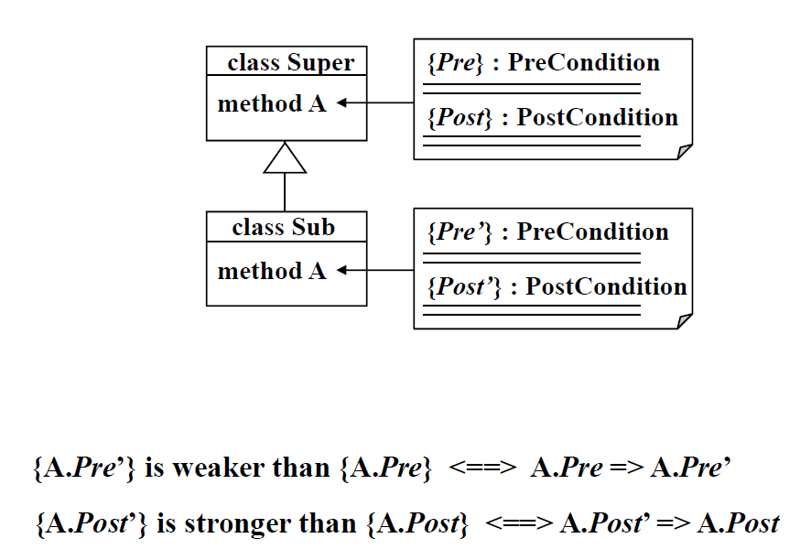
Inheriting Contracts_2

Slide 22
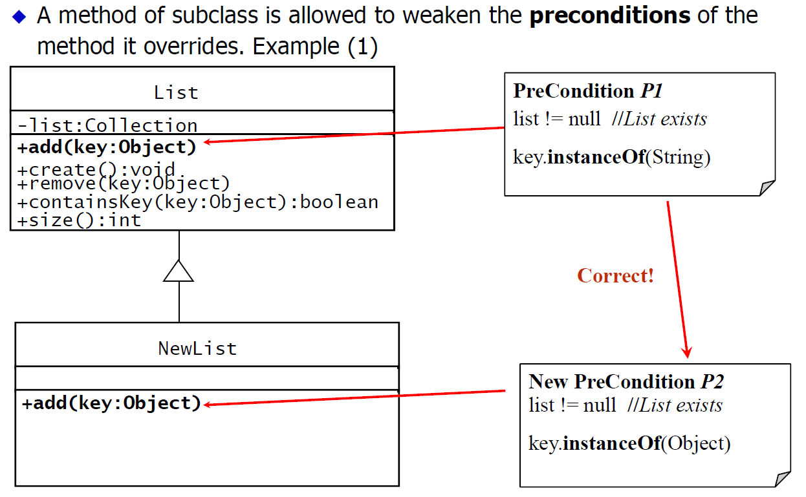
Inheriting Contracts_3

Slide 23
Inheriting Contracts_4

Slide 24
Inheriting Contracts_5

Slide 25
Inheriting Contracts_6

Slide 26
Managing Object Design
There are two primary management challenges during object design:
Increased communication complexity. The number of participants involved during this phase of development increases dramatically. The object design models, and code are the result of the collaboration of many people. Management needs to ensure that decisions among these developers are made consistently with project goals.
Consistency with prior decisions and documents. Developers often do not appreciate completely the consequences of analysis and system design decisions before object design. When detailing and refining the object design model, developers may question some of these decisions and reevaluate them. The management challenge is to maintain a record of these revised decisions and to make sure all documents reflect the current state of development.

Slide 27
Documenting Object Design
Object design is documented in the Object Design Document (ODD). It describes object design trade-offs made by developers, guidelines they followed for subsystem interfaces, the decomposition of subsystems into packages and classes, and the class interfaces.
The ODD is used to exchange interface information among teams and as a reference during testing. The audience for the ODD includes system architects (i.e., the developers who participate in the system design), developers who implement each subsystem, and testers.

Slide 28
Documenting Object Design_2
There are three main approaches to documenting object design:
Self-contained ODD generated from model. The first approach is to document the object design model the same way we documented the analysis model or the system design model: we write and maintain a UML model and generate the document automatically. This document would duplicate any application objects identified during analysis. The disadvantages of this solution include redundancy with the Requirements Analysis Document (RAD) and a high level of effort for maintaining consistency with the RAD. Moreover, the ODD duplicates information in the source code and requires a high level of effort whenever the code changes. This often leads to an RAD and an ODD that are inaccurate or out of date.

Slide 29
Documenting Object Design_3
There are three main approaches to documenting object design:
ODD as extension of the RAD. The second approach is to treat the object design model as an extension of the analysis model. In other terms, the object design is considered as the set of application objects augmented with solution objects. The advantage of this solution is that maintaining consistency between the RAD and the ODD becomes much easier as a result of the reduction in redundancy. The disadvantages of this solution include polluting the RAD with information that is irrelevant to the client and the user. Moreover, object design is rarely as simple as identifying additional solution objects. Often, application objects are changed or transformed to accommodate design goals or efficiency concerns.

Slide 30
Documenting Object Design_4
There are three main approaches to documenting object design:
ODD embedded into source code. The third approach is to embed the ODD into the source code. As in the first approach, we represent the ODD using a modeling tool (see Figure 9-14). Once the ODD becomes stable, we use the modeling tool to generate class stubs. We describe each class interface using tagged comments that distinguish source code comments from object design descriptions. We can then generate the ODD using a tool that parses the source code and extracts the relevant information (e.g., Javadoc [Javadoc, 2009a]). Once the object design model is documented in the code, we abandon the initial object design model. The advantage of this approach is that the consistency between the object design model and the source code is much easier to maintain: when changes are made to the source code, the tagged comments are updated and the ODD regenerated.

Slide 31
Documenting Object Design_5
The fundamental issue is one of maintaining consistency among two models and the source code. Ideally, we want to maintain the analysis model, the object design model, and the source code using a single tool. Objects would then be described once, and consistency among documentation, stubs, and code would be maintained automatically.

Slide 32
Documenting Object Design_6

Slide 33
Documenting Object Design_7
The first section of the ODD is an Introduction to the document.
The second section of the ODD, Packages, describes the decomposition of subsystems into packages and the file organization of the code. This includes an overview of each package, its dependencies with other packages, and its expected usage.
The third section, Class interfaces, describes the classes and their public interfaces. This includes an overview of each class, its dependencies with other classes and packages, its public attributes, operations, and the exceptions they can raise.

Slide 34
Documenting Object Design_8

Slide 35
Using Contracts During Requirements Analysis
Some requirements analysis approaches advocate the use of constraints much earlier, for example, during the definition of the entity objects. In principle, OCL can be used in requirements analysis as well as in object design.
In general, developers consider specific project needs before deciding on a specific approach or level of formalism to be used when documenting operations. Examine the following trade-offs before deciding when to use constraints for which purpose:

Slide 36
Using Contracts During Requirements Analysis_2
Communication among stakeholders. During software development, models support communication among stakeholders. Different models are used for different types of stakeholders. On the one hand, a use case or a user interface mock-up is much easier for a client to understand than an OCL constraint. On the other hand, an OCL constraint is much more precise statement for the class user.
Level of detail and rate of change. Attaching constraints to an analysis model requires a much deeper understanding of the requirements. When this information is available, either from the user, the client, or general domain knowledge, this results in a more complete analysis model. When this information is not available, however, clients and developers may be forced to make decisions too early in the process, increasing the rate of change (and consequently, development cost) later in the development.

Slide 37
Using Contracts During Requirements Analysis_3
Level of detail and elicitation effort. Similarly, eliciting detailed information from a user during analysis may require much more effort than eliciting this information later in the process, when early versions of the user interface are available and specific issues can be demonstrated. However, this approach assumes that modifying the components under consideration is relatively cheap and does not have a serious impact on the rest of the system. This is the case for user interface layout issues and dialog considerations.
Testing requirements. During testing, we compare the actual behavior of the system or a class with the specified behavior. For automated tests or for stringent testing requirements (found, for example, in application domains such as traffic control, medicine, or pharmaceuticals), this requires a precise specification to test against. In this case, constraints help a lot if they are specified as early as possible.

Slide 38
Conclusions related to Interface Specification
Identifying missing operations and writing contracts are overlapping activities. Writing contracts forces us to look carefully at each object and might result in finding new behaviors and boundary cases.
Writing contracts leads to additional helper operations for inspecting objects. Although the relevant object state is accessible by examining attributes and navigating relevant associations, writing simple contracts encourages us to add helper methods for examining state. This results in simpler constraints and classes that are more easily Testable.
Writing contracts leads to better abstractions. When inheriting contracts, only preconditions can be weakened. Postconditions and invariants can only be strengthened. Consequently, when writing contracts for abstract classes, we add abstract operations for describing properties of the concrete classes.

Slide 39
OCL – few operations on collections
/* All these are literal expressions – context independent */
Set{1,5,7,9, 8} - Set{2, 4, 6, 8, 5} = Set{1, 7, 9}
Set{1,5,7,9, 8}->symmetricDifference(Set{2, 4, 6, 8, 5}) = Set{1, 7, 9, 2, 4, 6}
Set{1,5,7,9, 8}->any(true) = 1
Set{1,5,7,9, 8}->any(i | i > 8) = 9
Set{1,5,7,9, 8}->any(i | i >= 7) = 7
Set{1,5,7,9, 8}->any(i | i >= 8) = 9

Slide 40
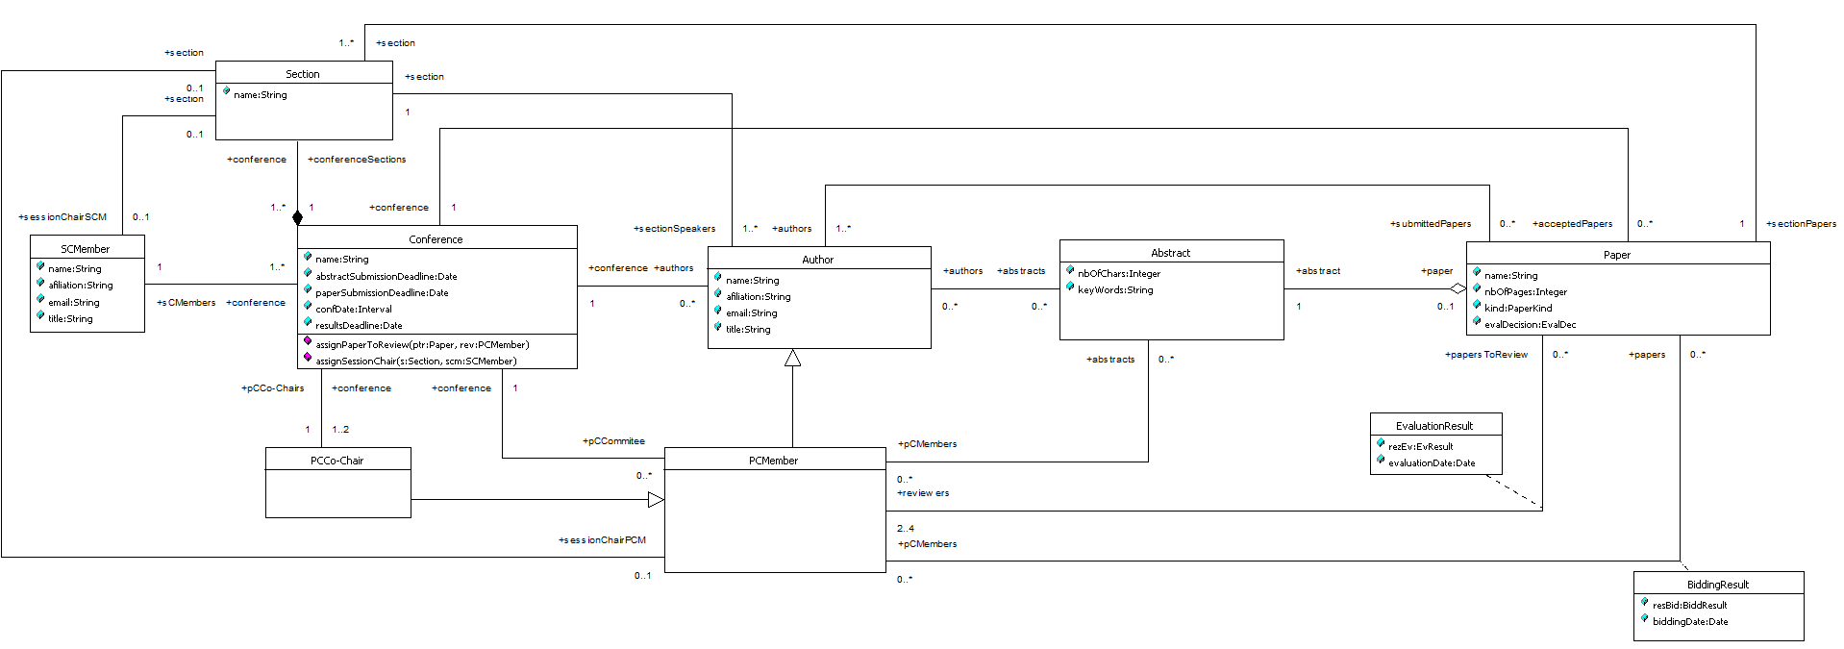
Conference Management – Specifying Interfaces
context PCMember
inv approprPapToReview:
self.papersToReview->select(p:Paper | Set{BiddResult::conflict, BiddResult::refuseToEv}->
includes(p.biddingResult->any(br| br.pCMembers->includes(self)).resBid))->isEmpty and
self.papersToReview.authors->excludes(self.oclAsType(Author))

Slide 41
Conference Management – Specifying Interfaces
context Conference::assignPaperToReview(ptr:Paper, rev:PCMember)
pre: ptr.reviewers->size < 4 and ptr.reviewers->excludes(rev) and
self.submittedPapers->includes(ptr) and self.pCCommitee->includes(rev) and
Set{BiddResult::conflict, BiddResult::refuseToEv}->excludes(ptr.biddingResult->
select(br | br.pCMembers = rev)->any(true).resBid)
post: ptr.reviewers->includes(rev) and ptr.reviewers->size = ptr.reviewers@pre->size + 1

Slide 42
Conference Management – Specifying Interfaces
context PCMember
inv sessionChair:
not self.oclAsType(PCMember).section.isDefined implies
self.oclAsType(PCMember).section.sectionSpeakers->excludes(self.oclAsType(Author))

Slide 43
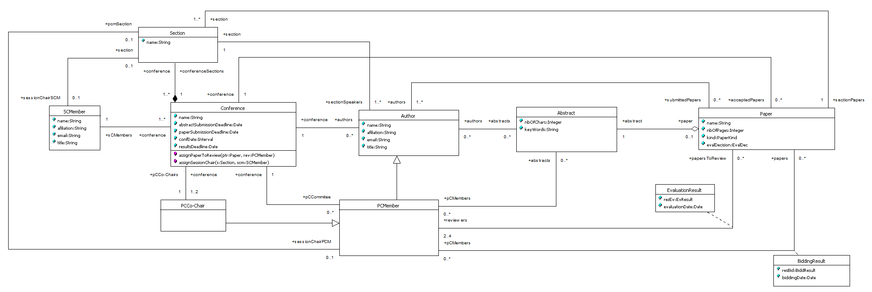
Conference Management – Specifying Interfaces
The previous OCL specification, using uppercast for the section property visible in the PCMember context was made for an uncompilable model because in the namespace of PCMember there is a conflict name. The correct solution is this.
context PCMember
inv sessionChair:
not self.pcmSection.isDefined implies
self.pcmSection.sectionSpeakers->excludes(self.oclAsType(Author))

Slide 44
Conference Management – Specifying Interfaces
context Conference::assignSessionChair(s:Section, scm:SCMember)
pre:
s.sessionChairSCM.isUndefined and s.sessionChairPCM.isUndefined and
self.sCMembers->includes(scm) and self.conferenceSections->includes(s)
post: not s.sessionChairSCM.isUndefined /* isUndefined is oclIsUndefined() */

Slide 45
Conference Management – Specifying Interfaces
context Conference
def acceptRejectUndecided:
let allEvalResBorderline:Set(Paper)=self.authors.submittedPapers->asSet->select(p:Paper |
p.evaluationResult.rezEv->forAll(rE | rE=EvResult::borderlinePaper))
let acceptedPapersC: Set(Paper) = self.authors.submittedPapers->asSet->select(p:Paper |
Set{EvResult::strongAccept, EvResult::accept, EvResult::weakAccept,
EvResult::borderlinePaper}->includesAll(p.evaluationResult.rezEv))-allEvalResBorderline

Slide 46
Conference Management – Specifying Interfaces
context Conference
def acceptRejectUndecided:
let rejectedPapersC: Set(Paper) = self.authors.submittedPapers->asSet->select(p:Paper | Set{EvResult::strongReject, EvResult::reject, EvResult::weakReject, EvResult::borderlinePaper}->
includesAll(p.evaluationResult.rezEv))-allEvalResBorderline
let undecidedPapersC:Set(Paper) = self.authors.submittedPapers->asSet –acceptedPapersC
- rejectedPapersC

Slide 47
Conference Management – Specifying Interfaces
context Section
inv sessionChair:
self.sessionChairSCM->isEmpty xor self.sessionChairPCM->isEmpty

Slide 48
Advices for understanding/learning OCL
Use an OCL tool!
Specify the model using UML
Specify OCL looking at the model!
Start with the context (the visibility domain) and with the kind of specification: inv:, pre:, post:, def:, def: let:, body:
In case of pre & post mention the full signature of the method
Use self even if this seems to be redundant
Compile de specifications
Instantiate the model by means of snapshots
Evaluate the model
In the Foundation package of the UML 1.5 metamodel, OCLE show you the signature of all: collections, OclAny, Boolean, Integer, Real, String

